Slide 1


Slide 2
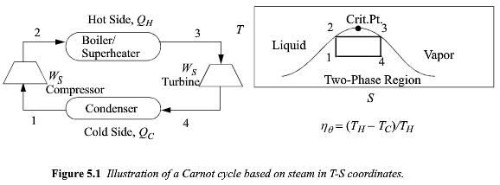
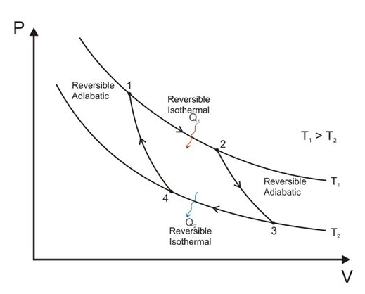
Carnot Cycle
Area inside of TS curve is Q_{H}
Area inside of PV curve is W_{S}
Efficiency is the ratio of these two

Slide 3
Carnot Cycle
1) T_{c} = 374°C T_{coal} = 1800°C
Operation with superheated steam has a lower ΔT
2) Wet steam kills turbine blades
3) Complex to compress mixed V/L stream

Slide 4
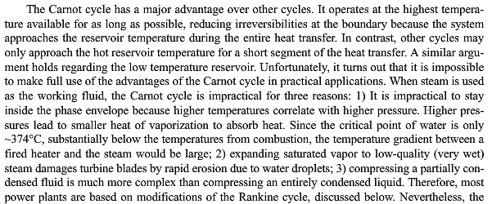
Carnot Cycle

Slide 5
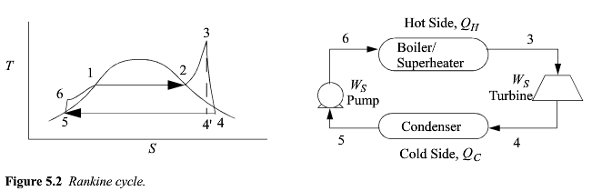


Slide 6
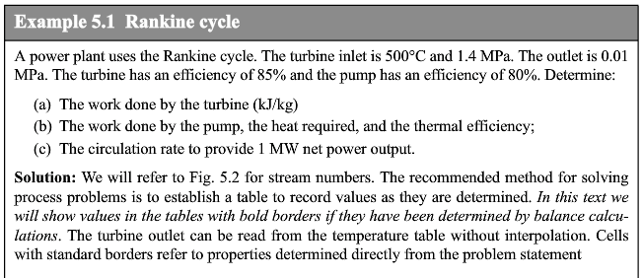
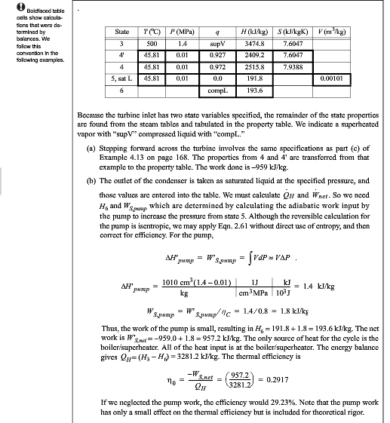

Slide 7


Slide 8
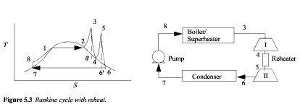

Slide 9
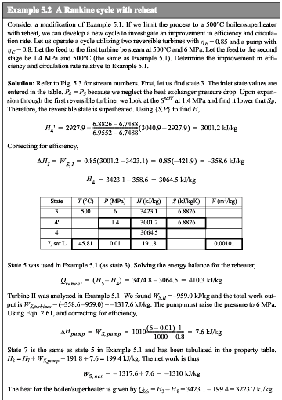

Slide 10
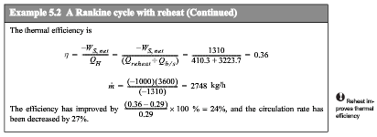

Slide 11
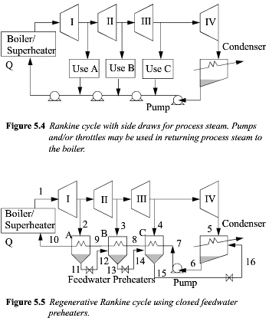
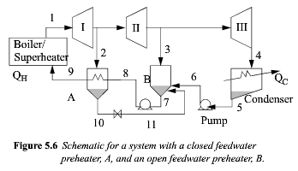

Slide 12
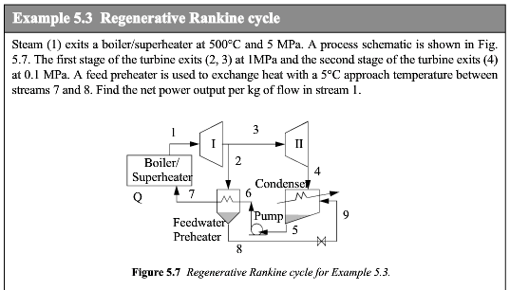
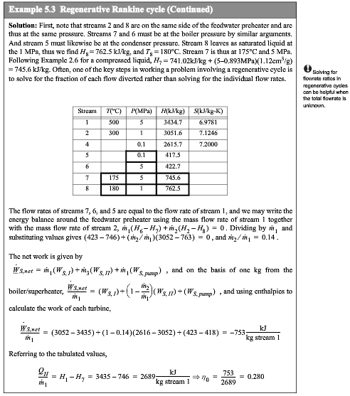

Slide 14
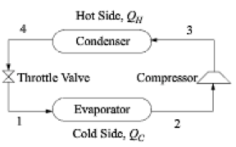
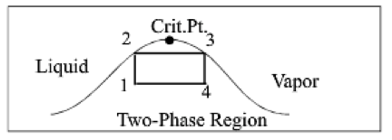

Carnot Heat Pump
4
T
2
S

Slide 15
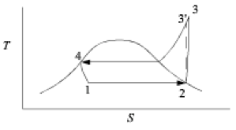
Carnot Heat Pump
4
T
2
S
Ordinary Vapor Compression Cycle (OVCC)
Modify so that:
-Saturated vapor enters compressor
-Saturated liquid enters throttle
-Throttle is isoenthalpic (isothermal)

Slide 16

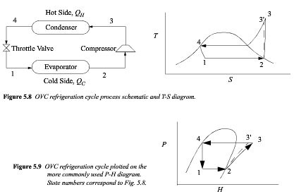
-Saturated vapor enters compressor
-Saturated liquid enters throttle
-Throttle is isoenthalpic (isothermal)

Slide 17
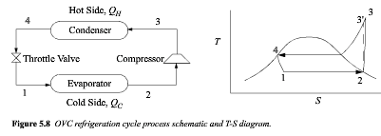
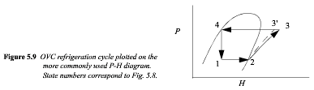
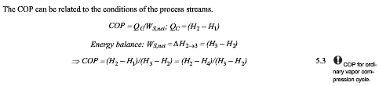
ΔH = 0
Throttle

Slide 18
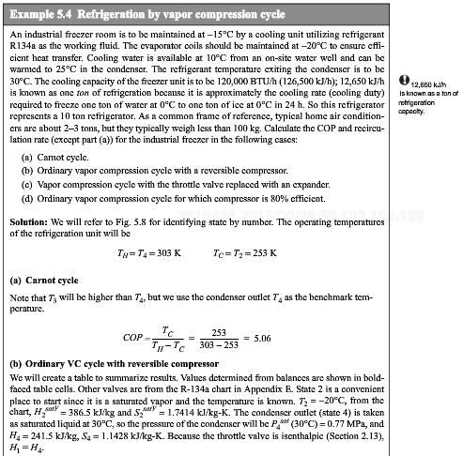
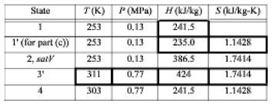
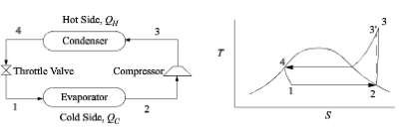

Slide 19
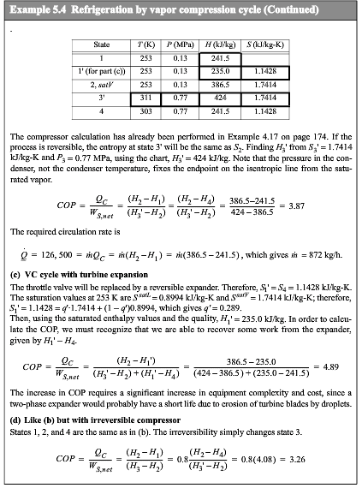

Slide 20
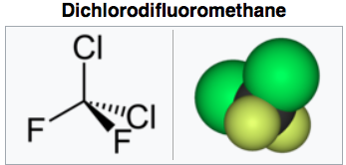
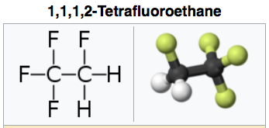
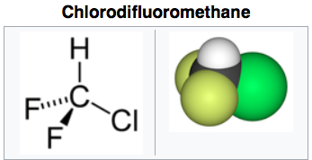
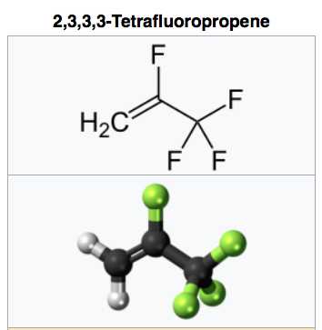

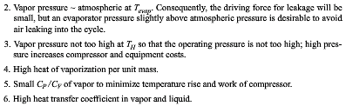
R-22
R-12
R-134a
HFO1234yf

Slide 21
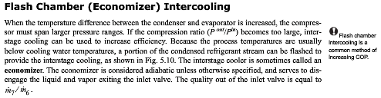
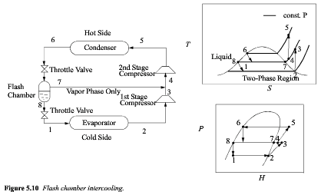

Slide 22
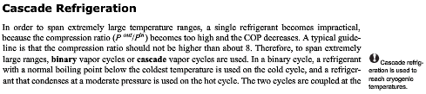
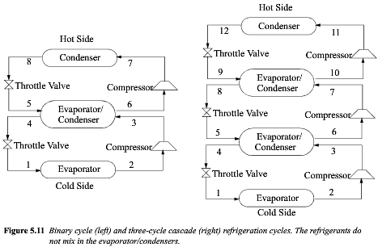
-Span large ΔT
-Use different refrigerants
-Compression ratio, P₃/P₂ < 8
Liquification of natural gas
ammonia, ethylene, methane
-Heat transfer requires a T differential

Slide 23
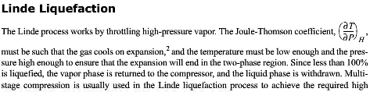
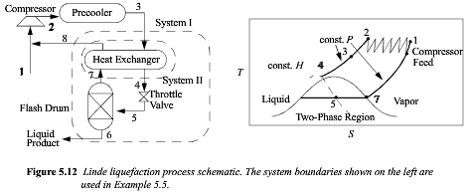
-Throttle high-pressure vapor
-Positive Joule-Thomson coefficient
(δT/δP)_{H}
-Expand to the 2-phase region
liquify less than 100%
-Return vapor to compressor
-Product is liquid
-Use multistage compression

Slide 24
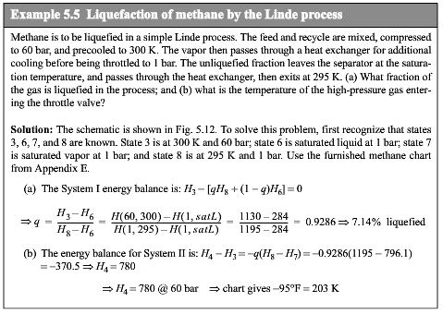
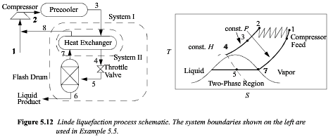

Slide 25
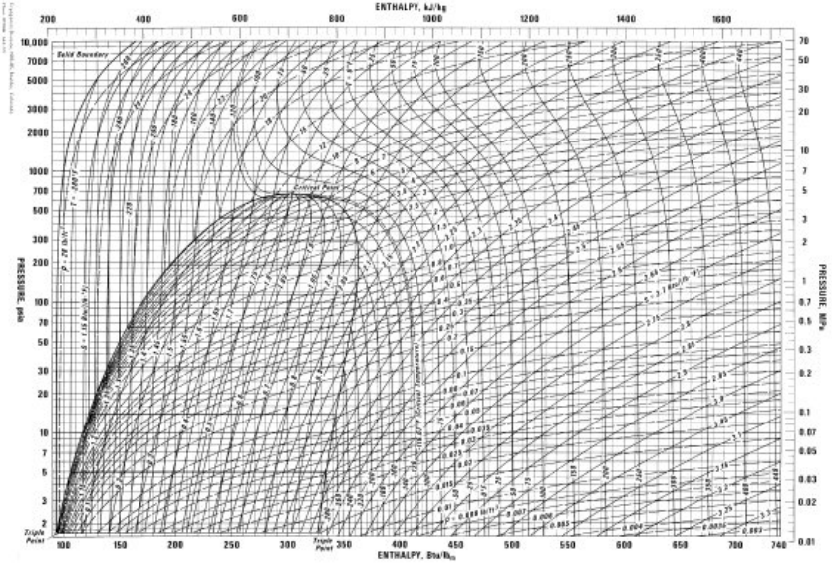
Methane

Slide 26

